Slide 1
Innovative environmental solutions in energy, water and waste
CWD Facility Tour
www.veolianorthamerica.com

Slide 2
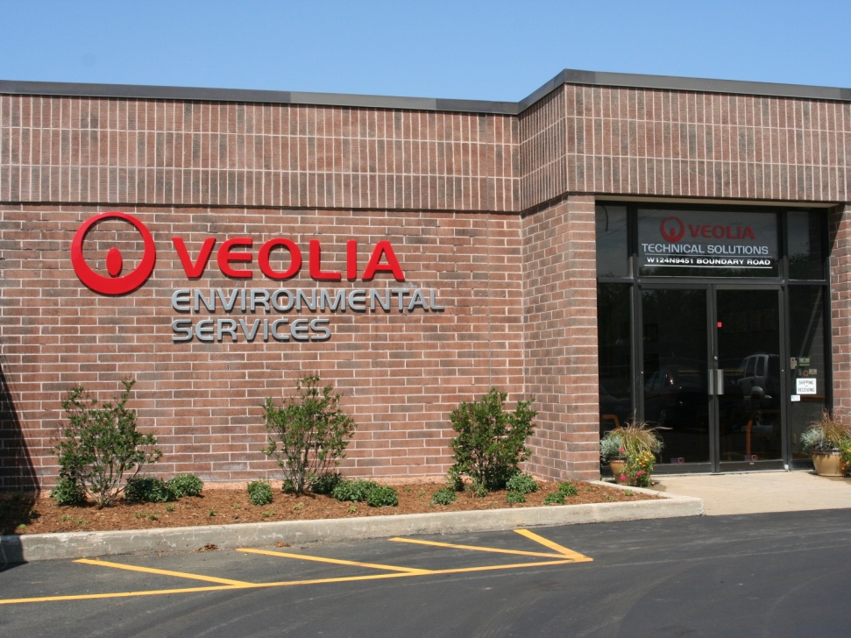
Veolia ES Technical Solutions- Menomonee Falls Facility
Wisconsin DNR Green Tier Facility with ISO14001 audited and certified EMS
1997 permit modification allowed material that was traditionally routed to incineration to recycling or treatment.
Stabilization
Non Hazardous waste solidification
Drum trans-shipment
Depacking and bulking
HHW collection

Slide 3
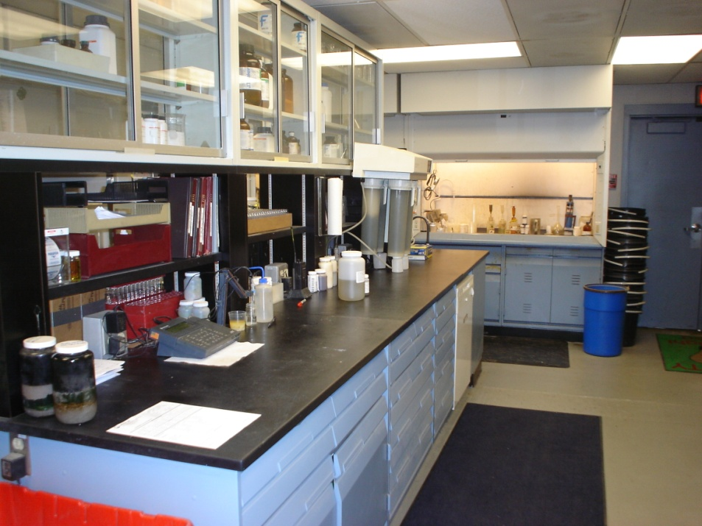
Laboratory
WDNR Certified
VES-TS internal lab audits
Supports the operations of the facility
TCLP for RCRA metals
PCB analysis
Fingerprint analysis

Slide 4
Tracking
AS400 based waste tracking system
Integrated with field computers and other VES-TS sites around the U.S.
Immediate tracking
Bar coded labels

Slide 5
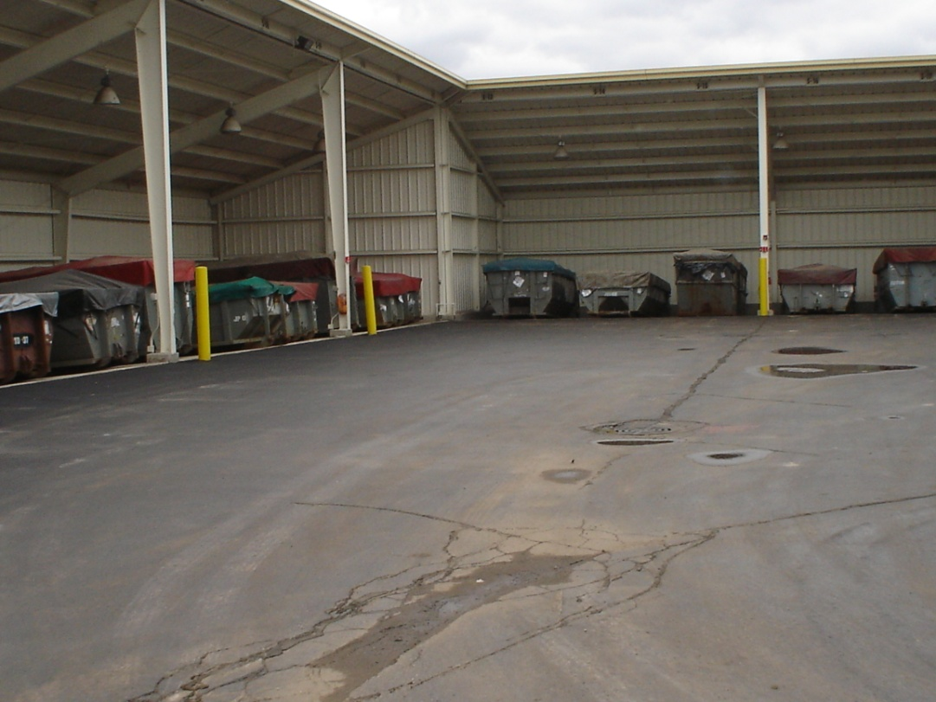
48 Unit or “F-Shape”
Storage for bulk solids
Staging for stabilization
Staging for trans-shipment
Blind sump containment
48 roll off capacity

Slide 6
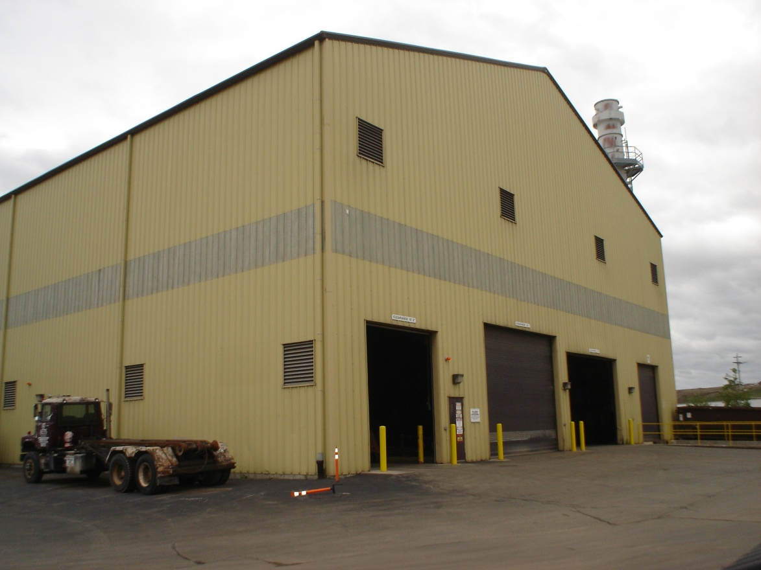
Stabilization
Chemical Stabilization of inorganic RCRA metal bearing waste
Bulking of solids for off site treatment or disposal
5,500 tons treated on Average annually
Approximately 15% of waste received is stabilized
Steel lined, cement encased pit with baghouse for dust
Typical reagents are CKD, Portland Cement, Ferrous Sulfate

Slide 7
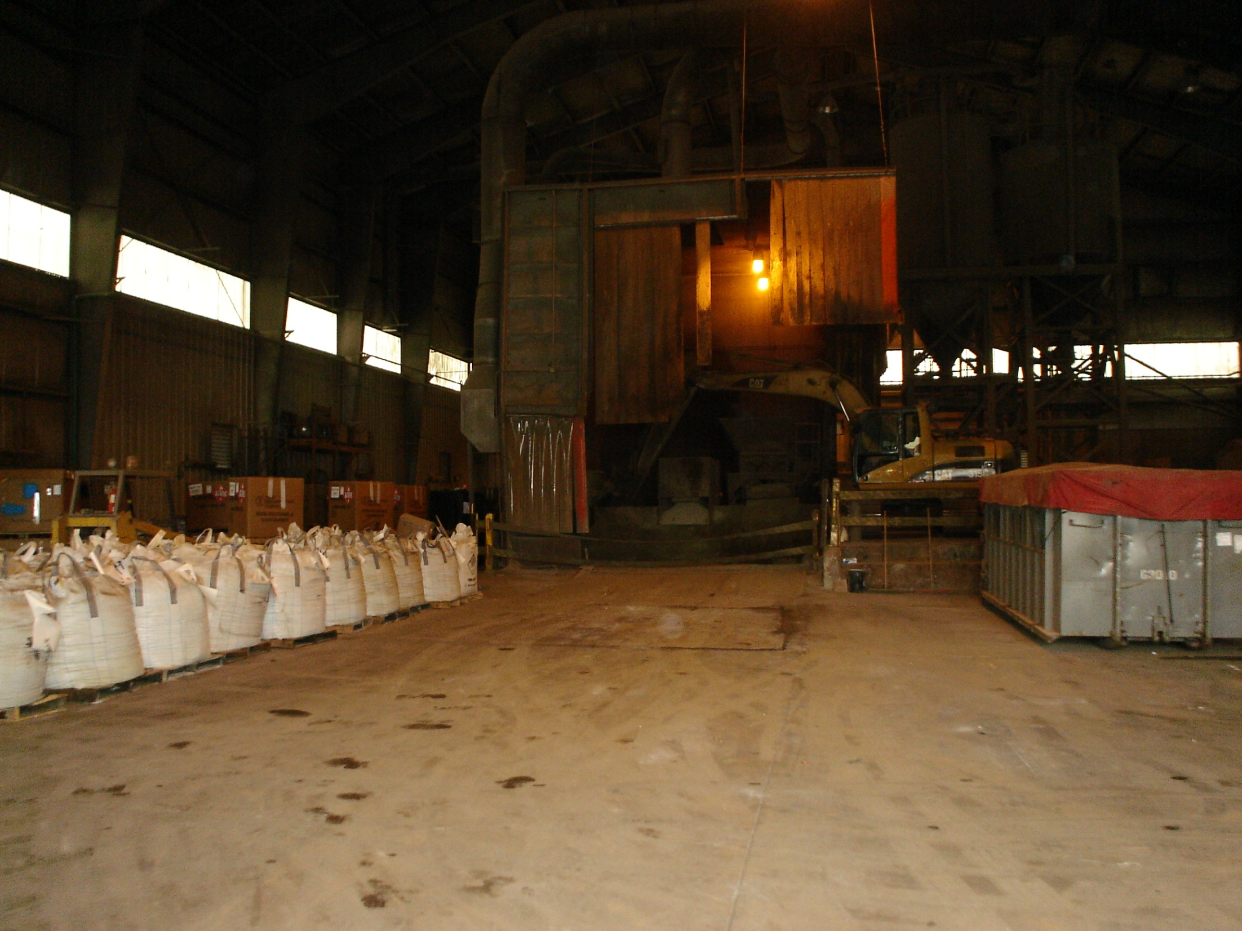

Slide 8
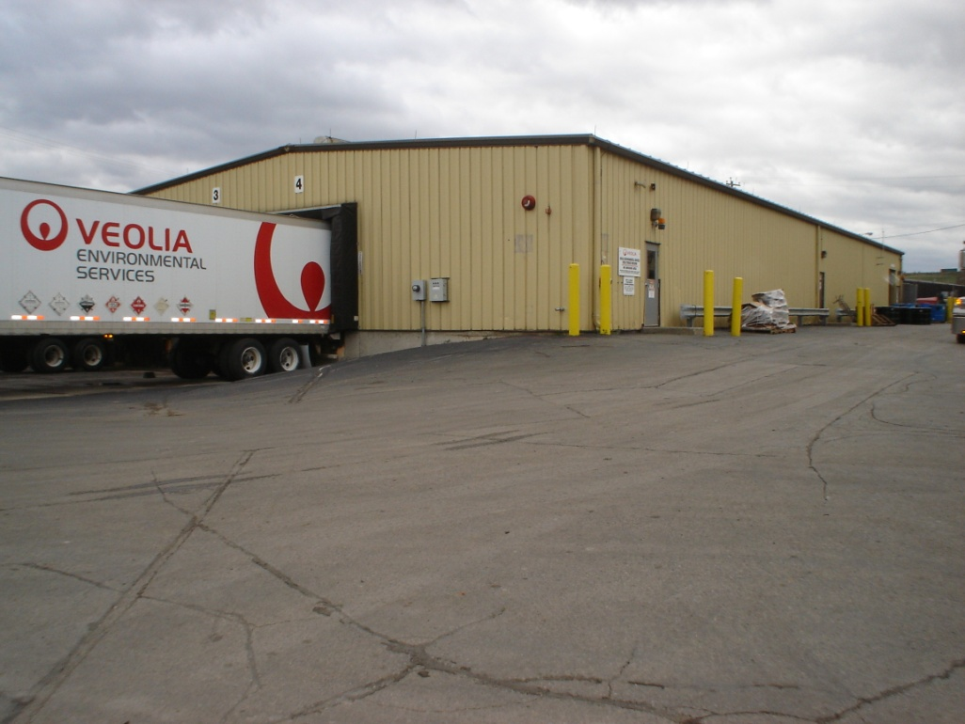
800 Unit or Drum Building
Capacity is 44,000 gallons or 800 55 gallon drum equivalents
Foam fire suppression system
Sample and trans-ship containers
Repackage labpacks
All types of waste received

Slide 9
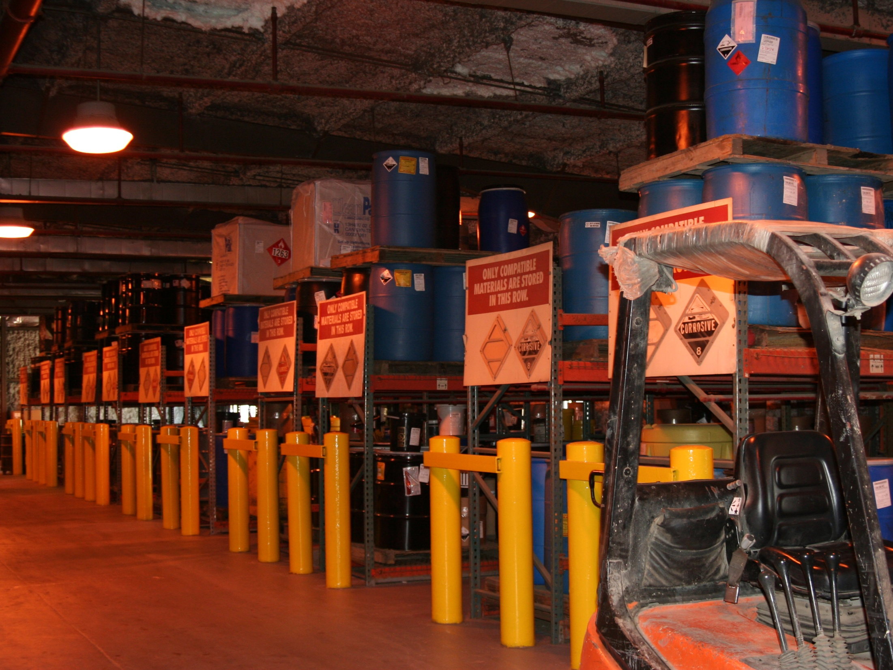

Slide 10
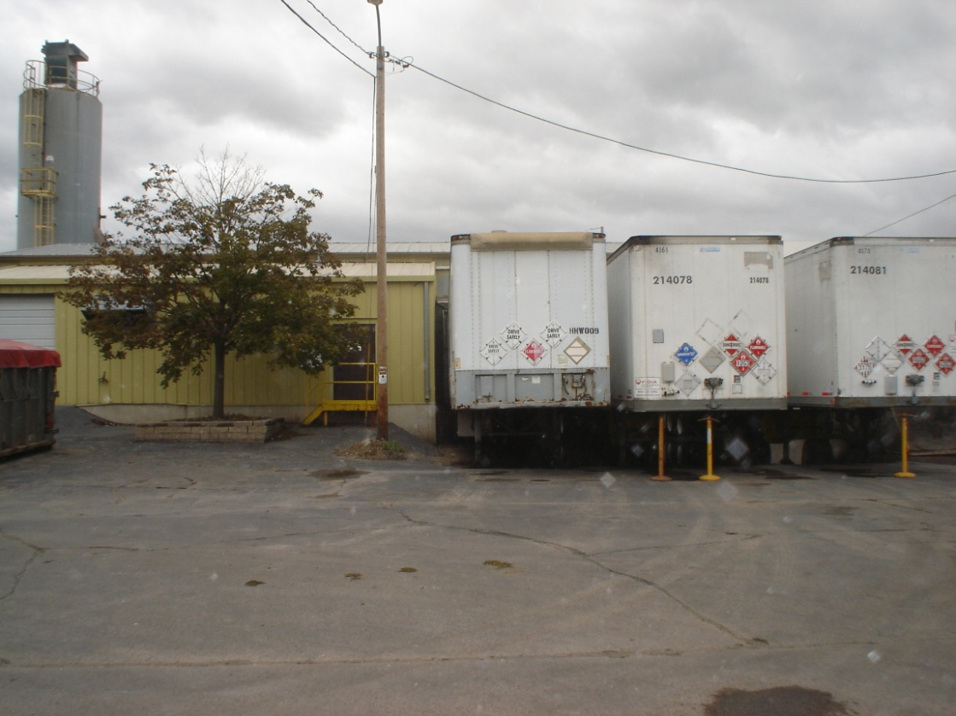
Non Hazardous Waste Processing
Process bulk and containerized non hazardous liquids and solids
Steel lined cement encased pit and excavator to mix
Unload and distribute HHW wastes
Around 8,000 tons of waste solidified annually
Approximately 35% of waste received is sent to this process

Slide 11
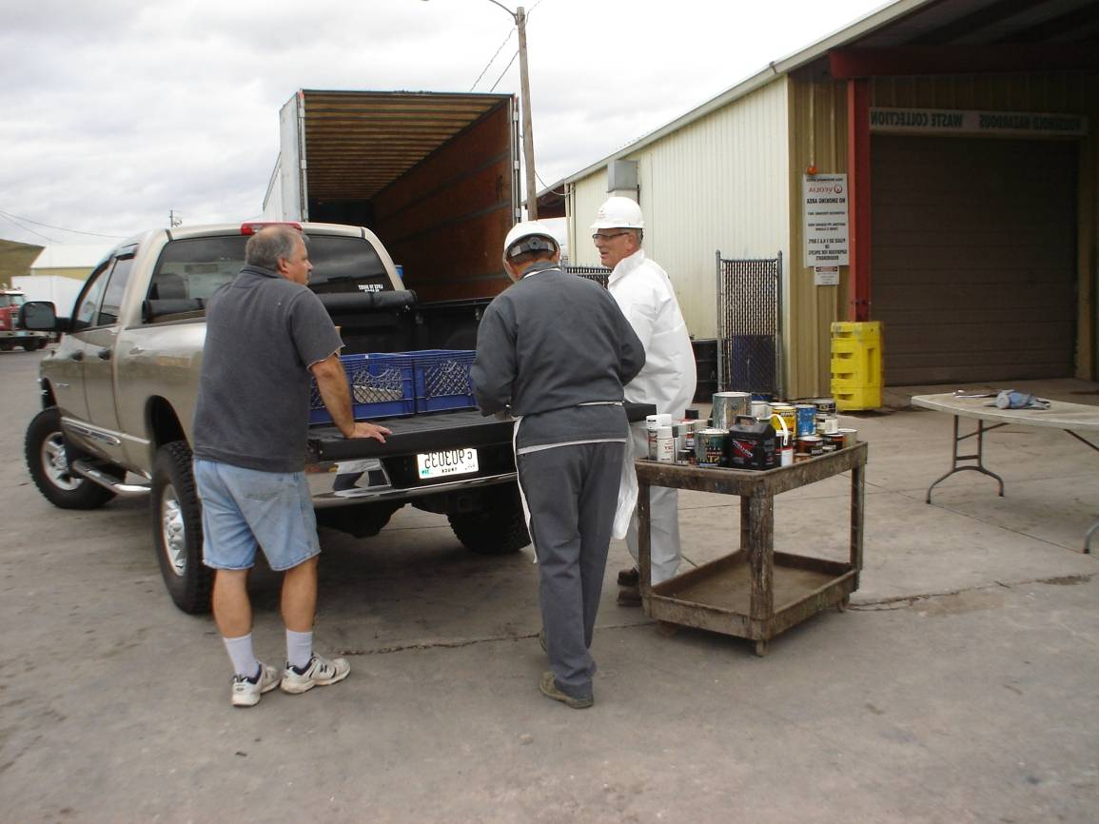
Household Hazardous Waste Collection
Service Milwaukee County and Waukesha County
Operates 3 days per week
Accepts VSQG’s by appointment
2012 collected >250,000 pounds including latex paint
>3,500 residents dropped off waste in 2012

Slide 12
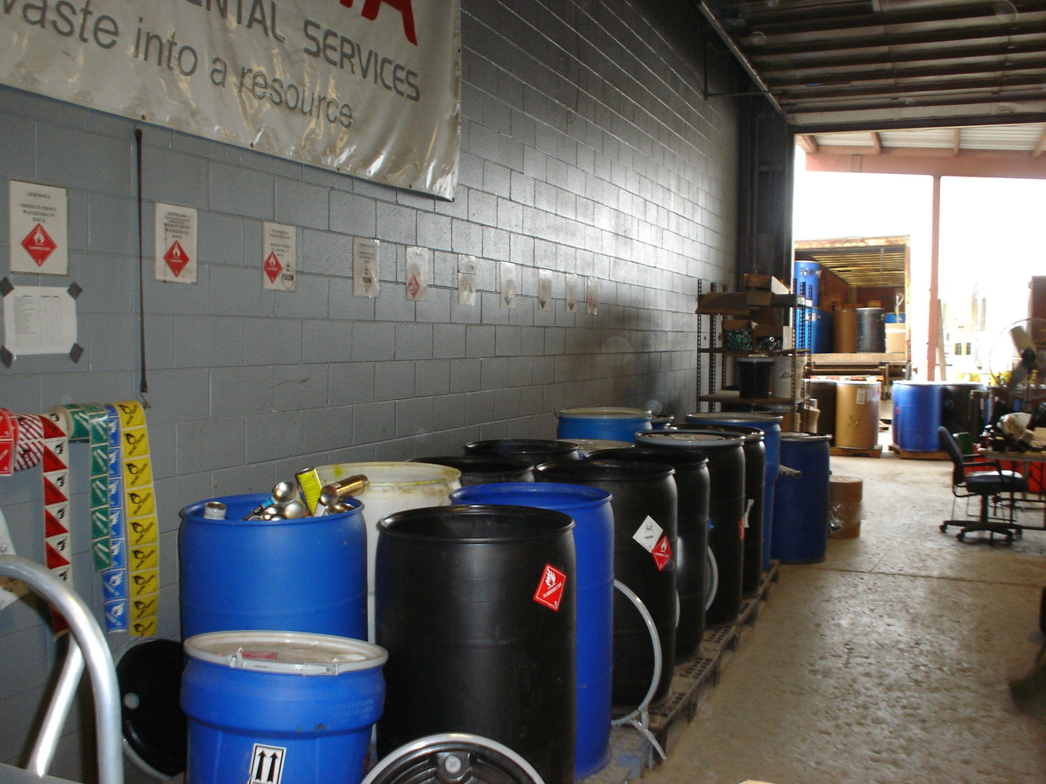

Slide 13
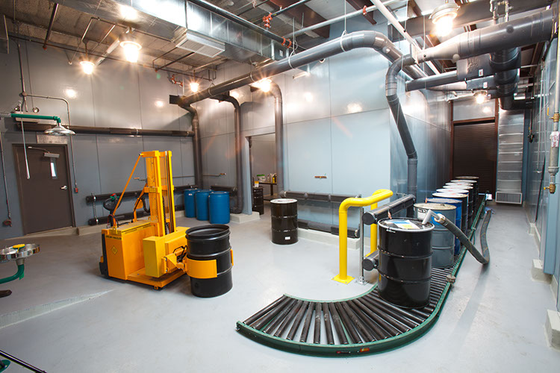
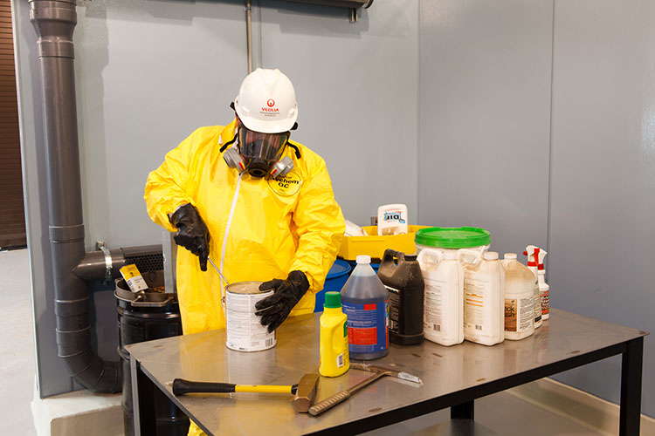
Depack and Bulking
Provides ability to route wastes to recycling or treatment instead of incineration
Unpack and pour up contents of labpacks
Bulk drums into tankers for recycling at cement kilns or to incineration
>750,000 gallons sent to cement kilns for recycling annually

Slide 14
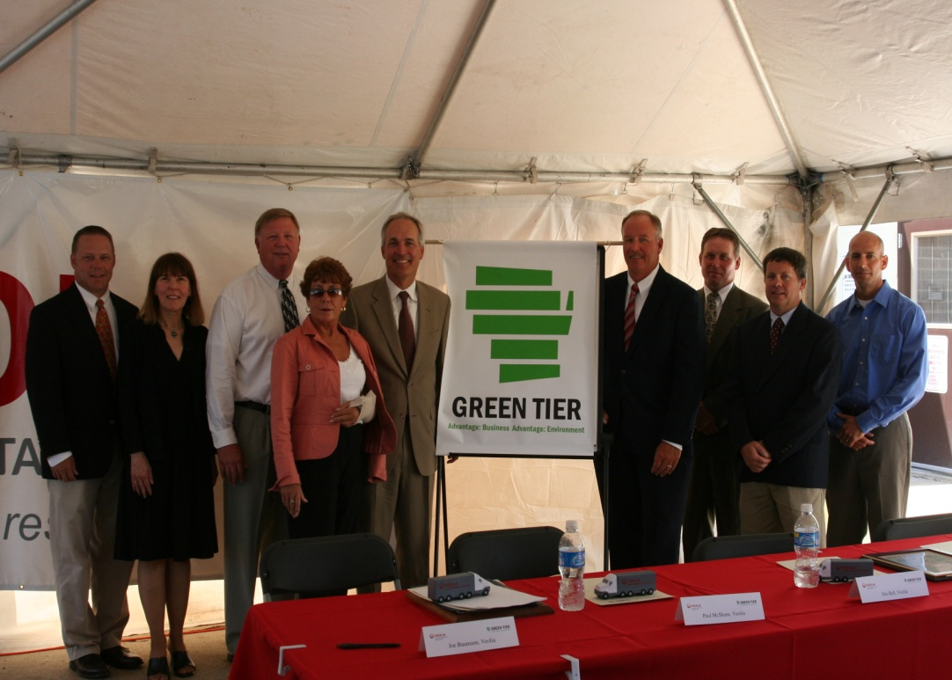
Green Tier
Became part of the program in July 2008
Had outside consultant certify EMS compliance with ISO14001 in June 2009 (renewed in 2012)
>750,000 gallons of high BTU liquids sent for fuel substitution and >60,000 gallons of oil to direct recycling
>13,000 metal and plastic drums recycled in annually
>110,000 pounds of wood pallets recycled in annually

Slide 15
QUESTIONS?

