Slide 2
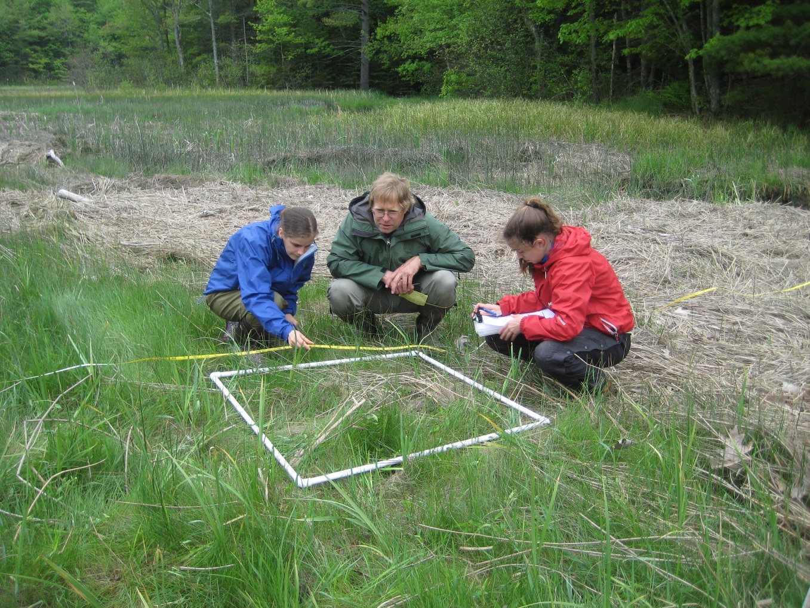
Curtis Bohlen Ph.D. Casco Bay Estuary Partnership

Slide 4
Tours
Portland International Jet Airport
Deicing Fluid Recovery, Solar Rooftop Panels, Geothermal Temp Regulated Terminal
Garbage to Garden Composting Facility
Curbside Pickup Servicing more than 8,000 customers
TOMRA Returnable Services LLC
World Leader in Sensor Based Sorting Tech
Ecomaine
Waste-to-Energy Plant
Riverside Recycling
Multiscale material processing, recycling, disposal and HHW

Slide 5
Conference Proceedings
More than 60 presentations over 3 days
HHW Programs/Operations
8 breakout sessions
Training & Education
5 breakout sessions
Toxicity, Chemical Persistence in Environment & Pollution
6 breakout sessions
Producer Responsivity
5 breakout sessions

Slide 6
HHW Programs/Operations
Paint Recycling
Innovative X-Green & RE-Mix Program
Community Waste Disposal, TX
Recycling OBP:The other High Value Paint We Shouldn’t Burn
Smarter Sorting
Latex Paint: Not Hazardous in the State of Massachusetts
Recolor Paints LLC
Packaging & Shipping Waste
HazChem:Understanding & Categorizing Reactive and Unstable Chemicals at HHWs
Hazardous Waste E Manifest: How Will This Impact Your Waste Shipments
Safely Shipping Dangerous Goods by Air and Ground

Slide 7
HHW Programs/Operations
Facility Design
Constructing a LEED Certified Moderate Risk Waste Collection Facility
Strategic Planning for HHW Programs: New Programs Expansion & Permanent Facilities
Facility Design, The Good, Bad and Ugly
HHW Successes
All for One, One for all: NJ Partnership for Success
Meaningful Milestones: Increasing Community Awareness & Engagement Through Anniversary Events
Minuteman HHP Facility

Slide 8
HHW Programs/Operations
Evolution of the HHW Field (Panel)
What a difference a decade makes
HHW and Special Waste Collection
SSRC’s Town Traveling HHW Show
Municipal Hazardous Special Waste Collection Program
HHW Operations
Regional Collections for High-Volume, Low Risk HHW
Maine Environmental Depot: Maines Permanent HHW Facility
Developing a Thorough and Efficient Request for Proposal
Reuse Programs
Reduce Waste & Support Your Community with Reuse
HHW Data: A Year in Reuse
Data in the HHW Industry

Slide 9
Training/Education
Emergency Preparedness
Chemical Safety & Climate Change Resiliency
Who? What? When? Questions in Emergency Preparedness
Mentoring
Using Peer Mentoring to Enhance Learning
Engaging Millennials to Their Full Potential
NAHMMA Resources for Members and Chapter Leaders
Behavior Change (pt1)
Behavior Change Training Workshop: Social Science Tools & Evidence Based Process
Behavior Change (pt2)
Behavior Change Training Workshop: Social Science Tools & Evidence based Process
Engaging Customer Relations
Great Meetings
Engaging in Difficult Conversations
Great Customer Service

Slide 10
Toxicity, Chemical Persistence, Environmental Pollution
Toxics in Products
Heavy Metals Continued Presence in Consumer Packaging
Lead Myths and Mistakes-Awareness That Can Reduce Lead Risk and Liability
Toxics in Products
Pollution Prevention
Cry of the Loon
Finding the Needle in the Golden Pond Haystack
Town and Gown: A Pollution Control Cooperative in Rural Communities
Reducing Toxins in Grocery Stores
Reducing Toxins & Combating Hazardous Waste Release in the Retail Grocery Sector (Panel Discussion)

Slide 11
Toxicity, Chemical Persistence, Environmental Pollution
Safer Products
Reducing Hazardous Cleaning Products in Schools & Childcare
Advancing Disclosures of Chemicals in Products & Reducing Reporting Burdens
Conducting Performance Testing & Hazard Assessments Before Implementing Change
Chemicals In Schools
Counting Your Chemicals: School Lab Inventory Project
Tennessee Schools Lab Rehab Program
Managing School Chemicals
Toxics in the Food & Beverage Industry
Making Changes in the Food and Beverage Industry
Avoiding Hidden Hazards in the Disposable Food Service Ware

Slide 12
Producer Responsibility
Extended Producer
Leveraging EPR to Benefit Local HHW/VSQG Programs
Drug Take Back: National Trends in Waste Household Medicine Management and the Rise of Pharmaceutical EPR
Fundamentals of a Compliant Healthcare Program (panel)
Mercury
Mercury Thermostats: A Blueprint for Hazardous Material Professionals
Mercury Added Thermostats Collection & Recycling: How States can coordinate for Better Results
Lessons from Countries Phasing Down Dental Amalgam

Slide 13
Producer Responsibility
Product Stewardship
Product Stewardship Programs for Managing Universal & Hazardous Wastes (Panel)
HHW Producer Responsibility
EPR for HHW: Holding Manufacturers Responsible for Safe HHW Management (Panel)

Slide 14
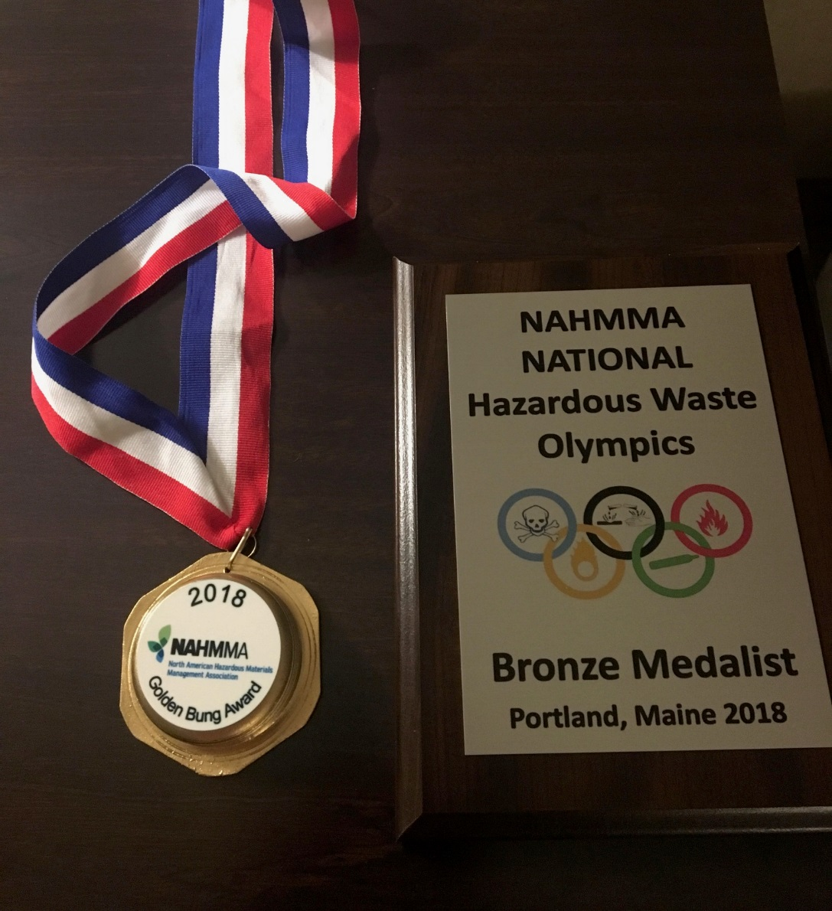
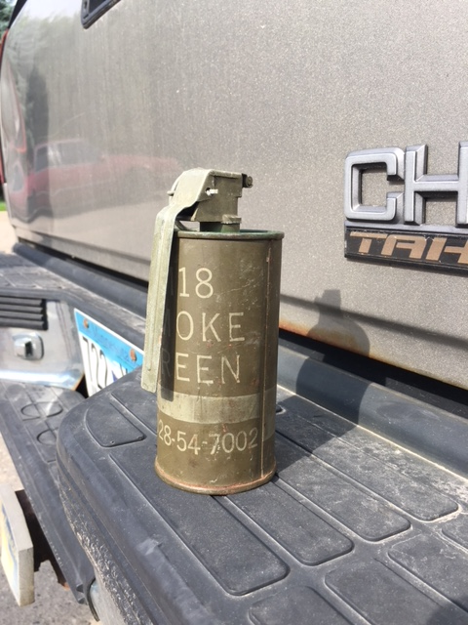
HHW Olympics/Golden Bung Awards

