Slide 1
Lessons From The HHW Front Line
TIME MANAGEMENT AND LEADERSHIP CONCEPTS

Slide 2
Introduction
Effective time management at the front end of a project or workday keeps you ahead of the workload and stress.
Efficient time management supports leadership by allowing more flexibility and creativity.
Notes:
As with any time management or leadership ideas, mine will not suit everyone, so apply them as best fits your situation and work style.

Slide 3
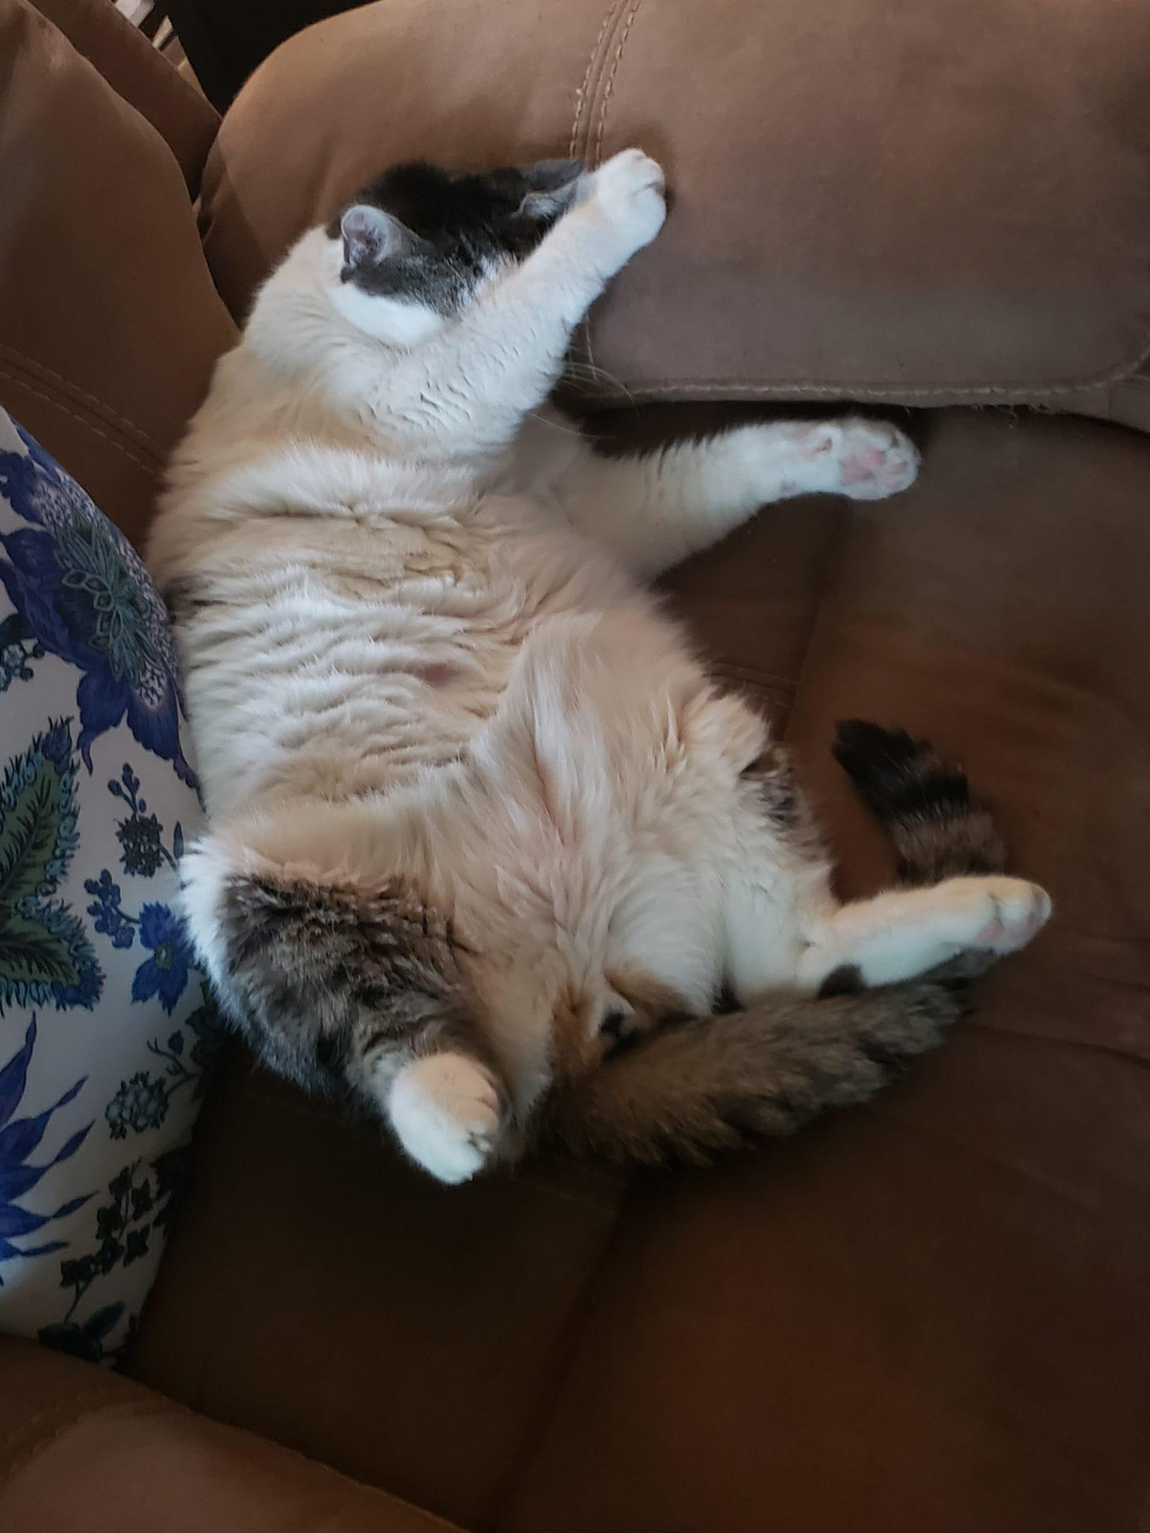
I’m Lazy
Notes:
I have no problem admitting it. I don’t want to spend extra time and effort on a task. I’m also proud and want my work to be high quality. Therefore, I look for efficiency and effectiveness in how I approach tasks.
As an undergraduate, I quickly learned that pulling all-nighters and rushing deadlines didn’t work for me, so I started to plan and work on projects early to keep up with ongoing work. Part of that plan was getting a full-night of sleep every day.
Several years later, I was working full-time while attending graduate school, including up to two-hour drives during my doctorate studies. This workload further focused my need to be as time efficient as I could.
From these experiences plus 35 years of work in academia and local government, these ideas grew.

Slide 4
Good Habits
Learn and reinforce good habits within yourself
Good habits make keeping up with tasks easier
Good habits require less mental effort to remember the task
Reward yourself for your good habits

Slide 5
Do the Small Things
If a new task takes a short time, say less than 5 minutes, do it right away.
Small tasks can accumulate to a large, intimidating compilation that becomes more difficult to start or complete
Make completing regular small tasks one of your good habits.
Small tasks are a good, productive break when you need time away from a large task.

Slide 6
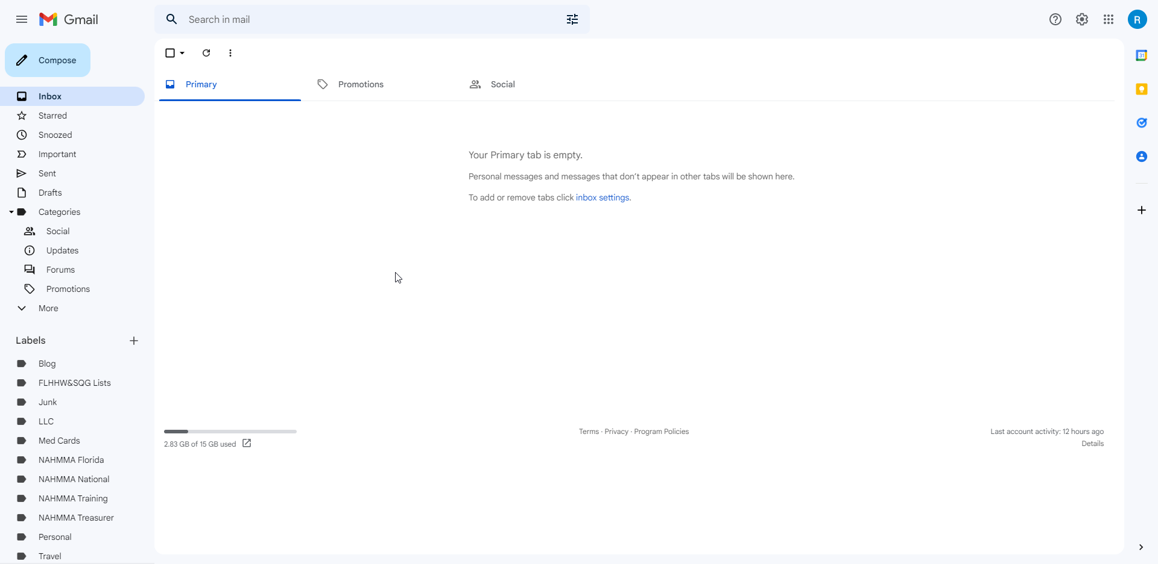
Emails: Read, Reply, File
When you sit down to check emails, create the following habits.
Read or delete every unopened email. If an email is unopened after a week, delete it because it is a low or zero priority
Reply to each email that requires it. A one-word or brief answer is often sufficient.
File or delete every email to an appropriate subject folder.
Don’t keep your email open all the time. Check email at discrete times for that activity. Don’t allow email notifications to disrupt other work.

Slide 7
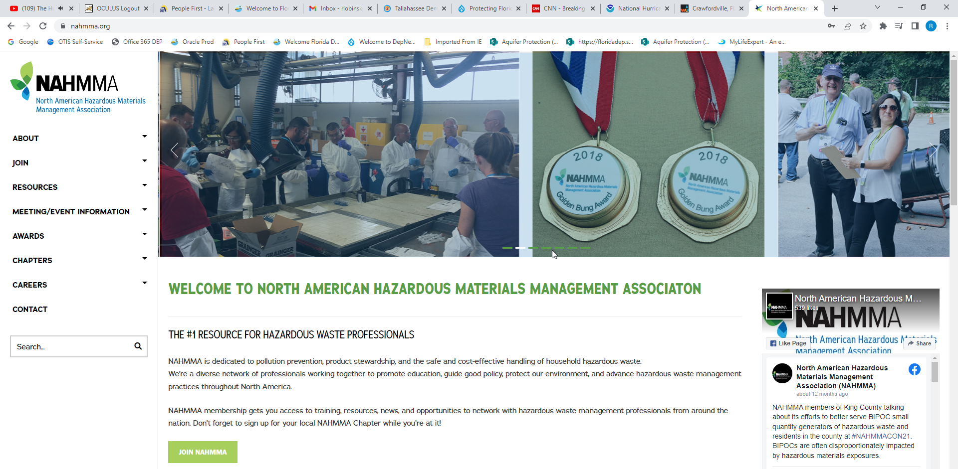
Single-Tasking
Research is clear that humans don’t truly multi-task. We rapid-switch between tasks.
Multi-tasking ends up being less effective and efficient because “gear changing” between tasks takes time and interrupts creative thinking.
Close inactive tabs on computers. 57 open tabs isn’t efficiency, it is distraction.
Concentrate on one task at a time.
Take breaks at good stopping points. Close and move to another, small task.
Take breaks when stalled. Come back with a fresh mind later.

Slide 8
Do Not Disturb
Set limits so that you can work uninterrupted.
Mute phone and email notifications.
Use a sign on your office door
Enforce the limits.
DO NOT
DISTURB

Slide 9
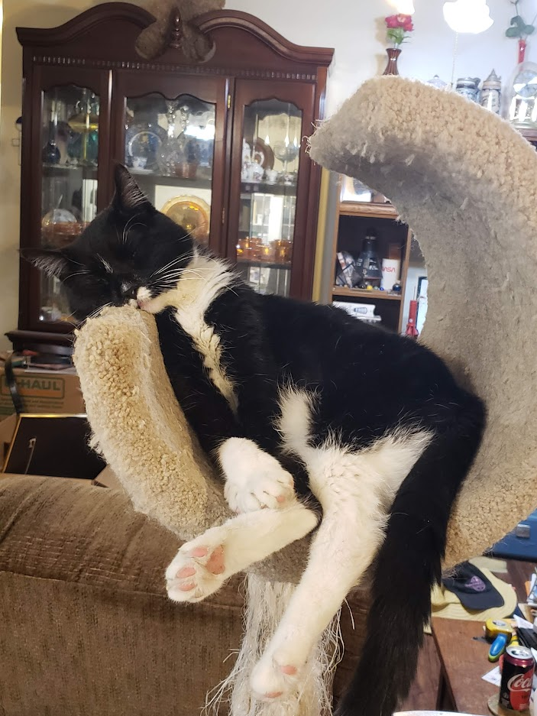
Take a Break
Fatigue is a creativity and efficiency killer
Regular breaks of just a few minutes enhances work-flow.
Regular short breaks improves morale and reduces stress.
Breaks can be recreational or shifting to another task.
Avoid working during meals.
Don’t use breaks as a procrastination tool.

Slide 10
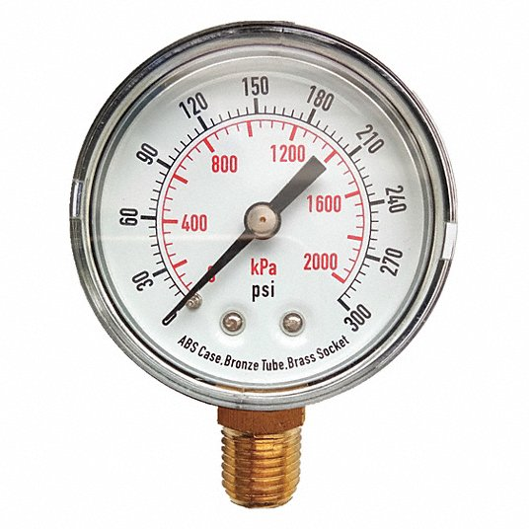
Do You Really Work Better Under Pressure?
Another idea not supported by research.
Start a project early and use all the allotted time.
Using the full amount of time allows for less rushed thinking and opportunity for the mind to contemplate the subject
Taking your time reduces errors
Having the time to look back over work can find errors to correct.
Taking the full amount of time is less stressful. You can take more breaks and rest.

Slide 11
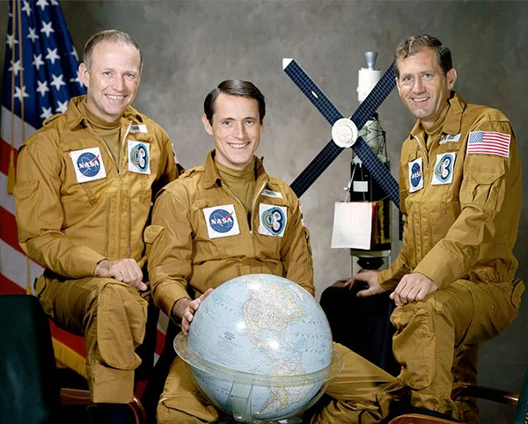
Overscheduling
The Skylab 4 mutiny/strike myth
Dense minute-by-minute scheduling based on poor assumptions.
Cleared up by discussion.
By end of mission, crew exceeded planned goals.
Notes:
Dense minute-by-minute scheduling didn’t allow for errors or slower than planned activity.
Schedules were based on end-of-mission pace of Skylab 3 crew after acclimation to microgravity
After a frank discussion, scheduling was adjusted to task-based with flexibility to adjust times.
By end of mission, crew exceeded planned goals.

Slide 12
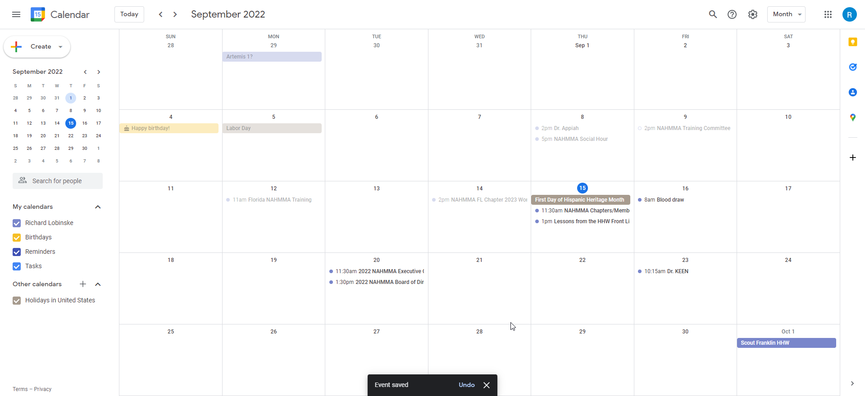
Scheduling Procrastination
I once heard advice to spend 30 minutes a day building a schedule. That’s 2.5 hours per work week of not working.
Spending excessive time creating a schedule gives the illusion of productivity while effectively postponing your start.
As much as possible, remain firm with your time commitments. Regularly rescheduling is another time killer.
Streamline schedules as much as possible.

Slide 13
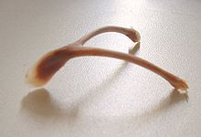
Wishing Doesn’t Make It So
Be realistic in time allotted for tasks and add a buffer for unexpected complications.
Don’t overcommit your time. No matter how sincere you may be, trying to fit too many hours of work into a limited time is self-defeating.

Slide 14
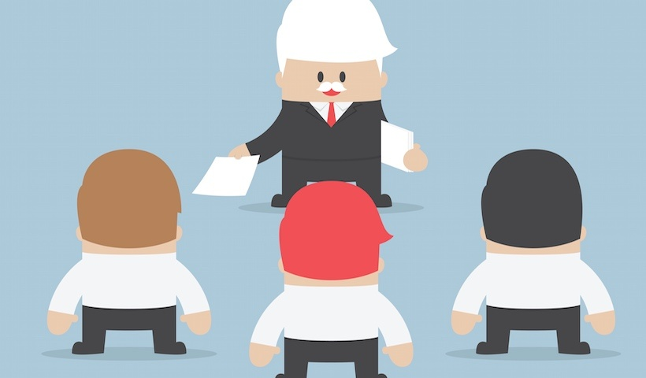
Delegate
You can’t do it all. Don’t try.
Keeps your schedule under control.
Use your team’s strengths. Select the optimal staff to cover a given task.

Slide 15
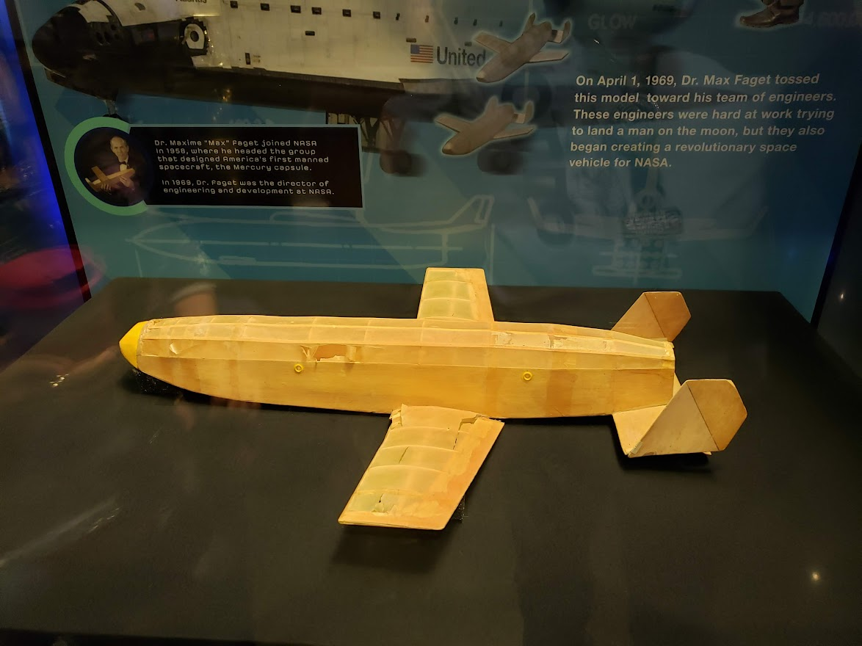
The Father of Invention
“Necessity is the Mother of Invention while laziness is the Father”
Necessity sets and defines the task.
Laziness finds the easiest and most efficient way to accomplish the task

Slide 16
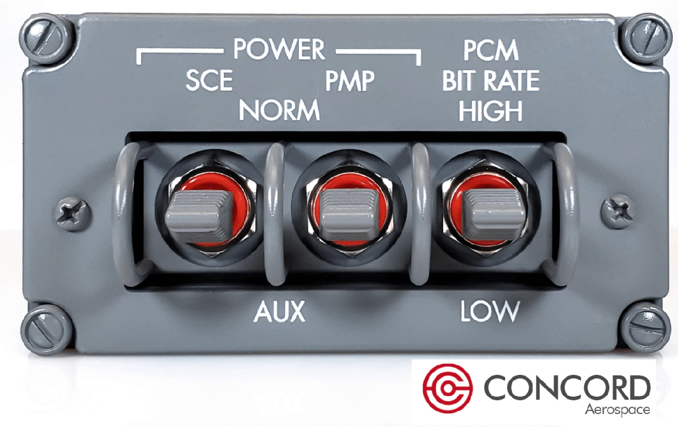
Trust the Team
Foster excellence within your team
With excellence established, trust their judgement
Trust goes both ways
Team knowledge is greater than the simple sum
Credit when credit is due.
Support the messenger

Slide 17
Trust the Team
Support the messenger. Staff should not be afraid to report mistakes.
From the Earth to the Moon:
Episode 4 “Spider”
Notes:
Grumman head of LM development Tom Kelly

Slide 18
Trust the Team
Support the messenger. Staff should not be afraid to report mistakes.
Failure Is Not An Option
Documentary
Notes:
EECOM John Aaron calls for SCS to Aux to clear problem on Apollo 12 after lighting strikes

Slide 19
Part of a Bigger Team
NAHMMA is a team and a family
Network with your peers
Training to fit HHW and SQG needs

Slide 20
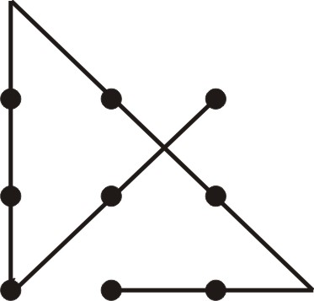
Thinking Inside the Box
The Outside the Box cliché is too often used to justify uninformed or misinformed ideas that don’t match the confines of the problem
The original concept was to avoid self-imposed limits
Apollo 13, Imagine Entertainment
Apollo 13

Slide 21
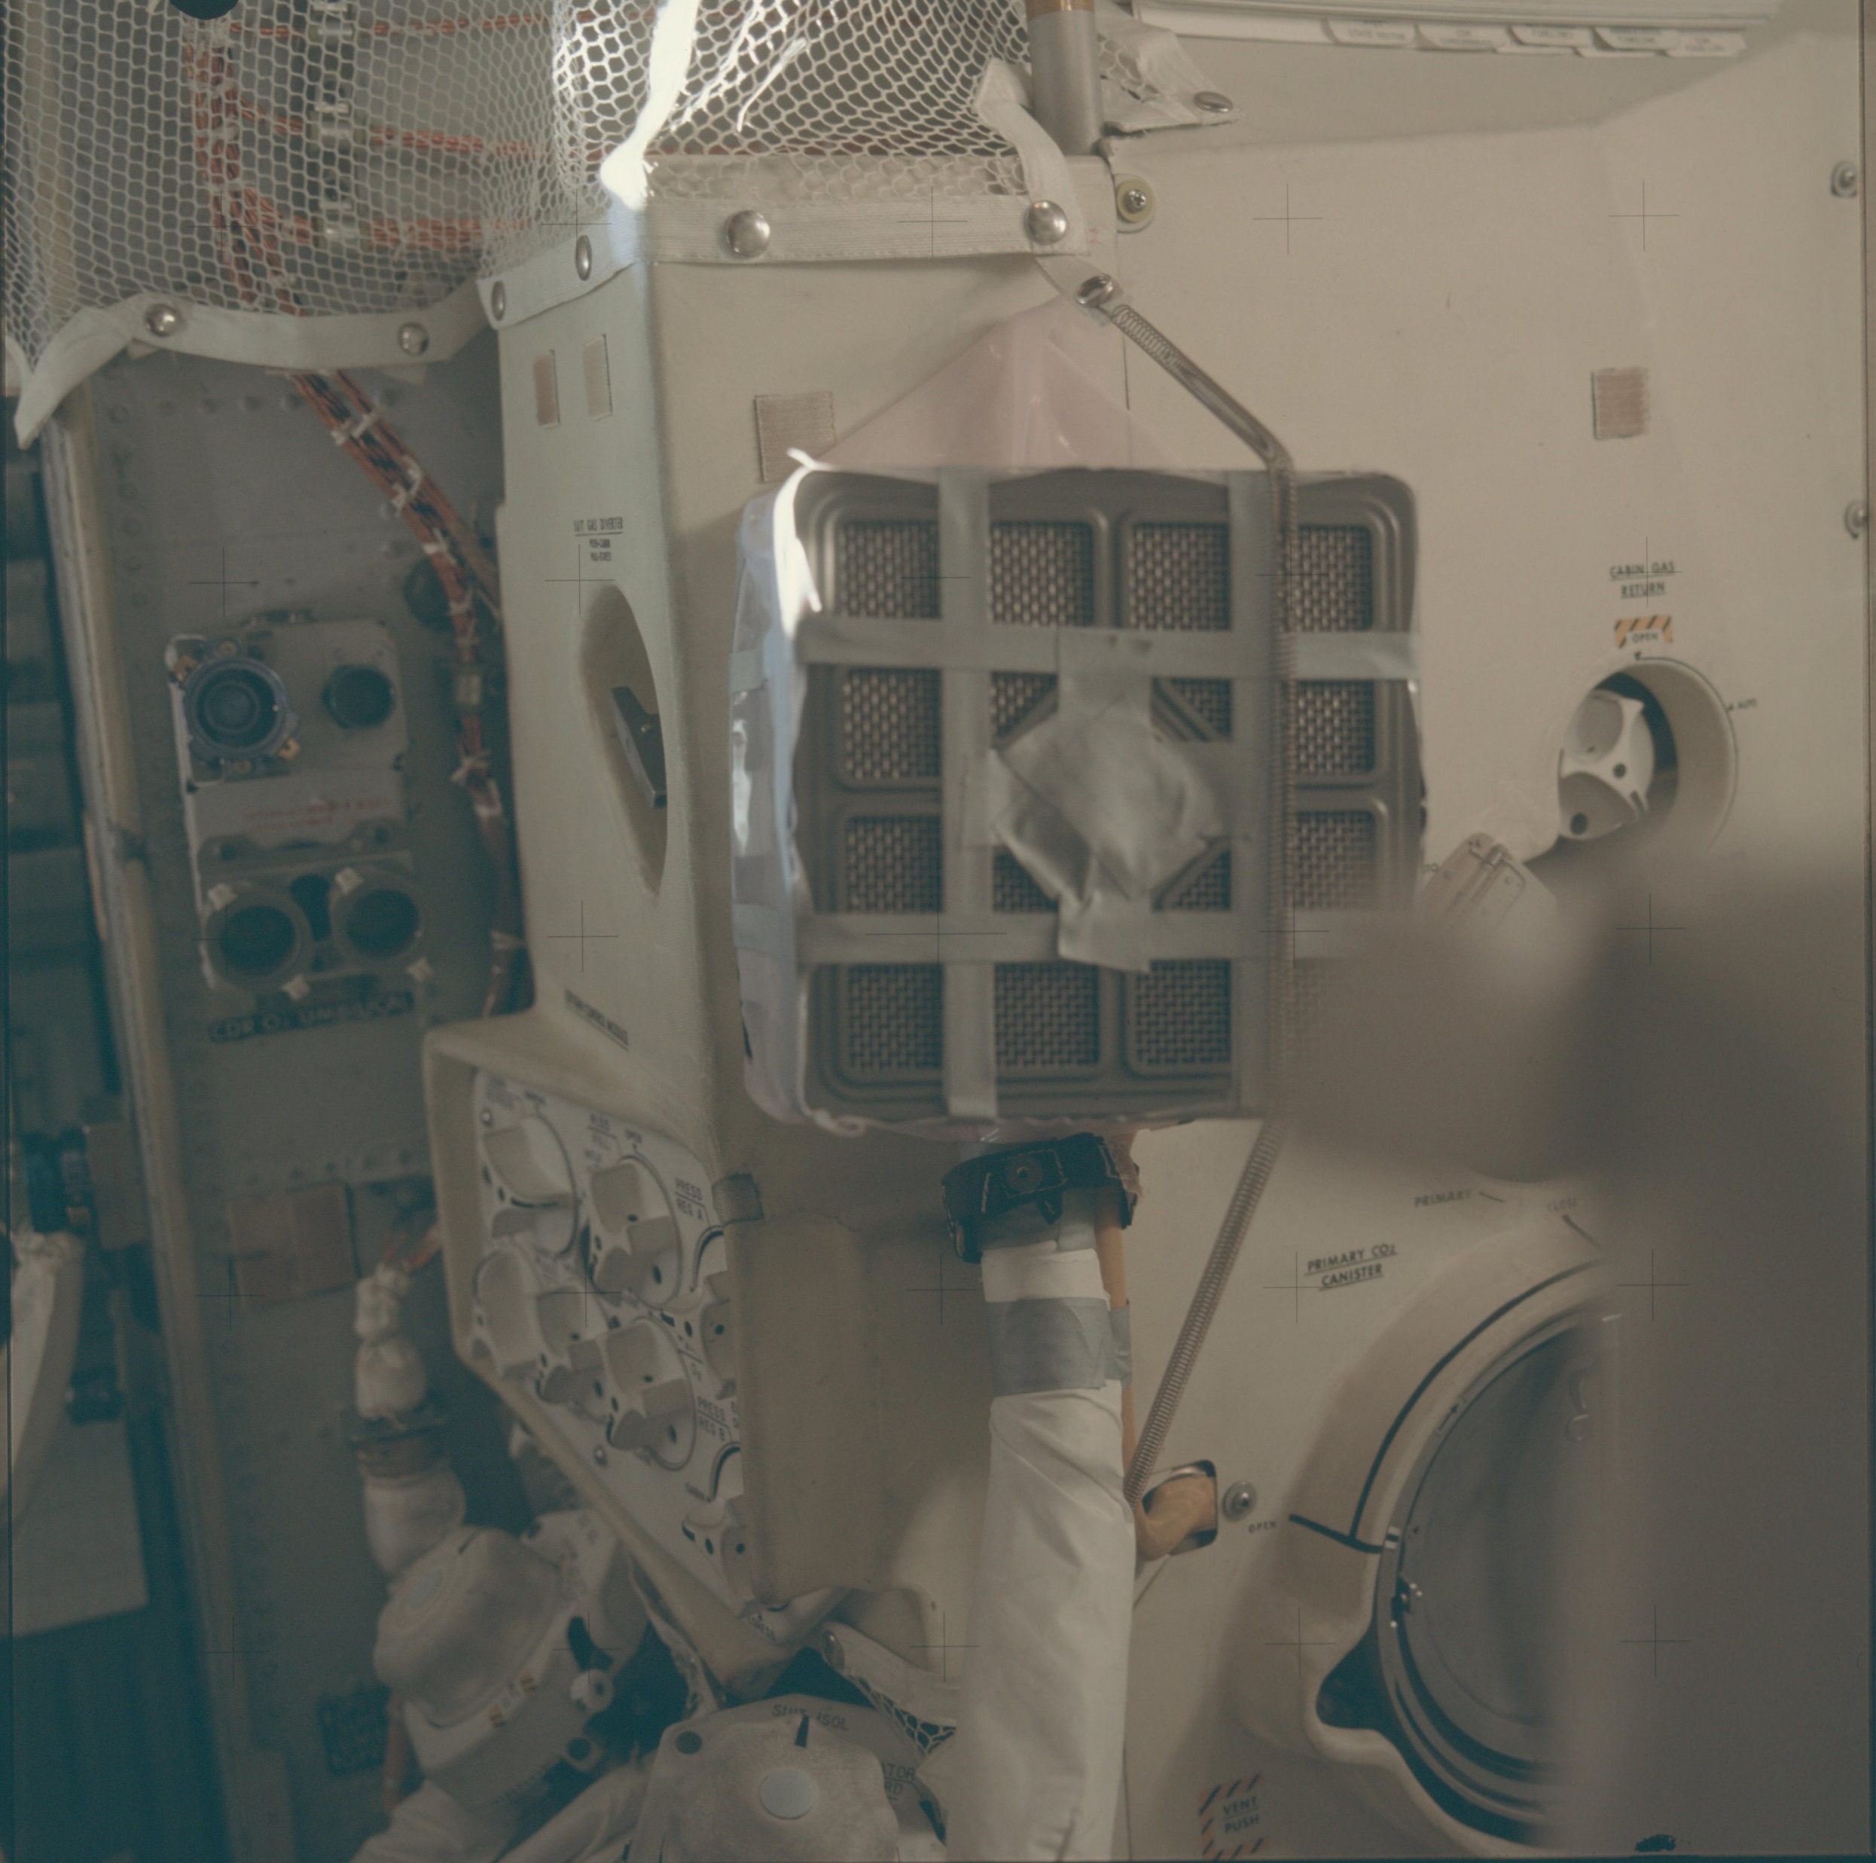
Thinking Inside the Box
Creativity involves developing a solution using the options available. The items inside the box.
AS13-62-8930
Apollo 13, Imagine Entertainment

Slide 22
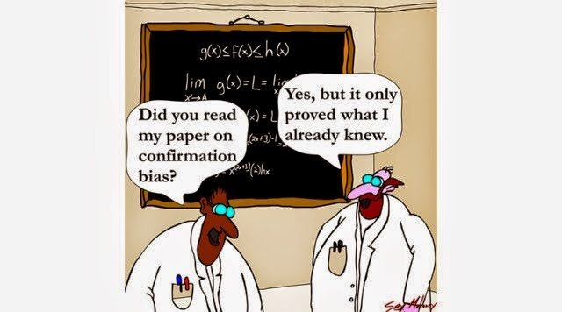
Confirmation Bias
Confirmation Bias: the bias of considering new evidence as confirmation of one’s concepts while ignoring contradictory evidence.

Slide 23
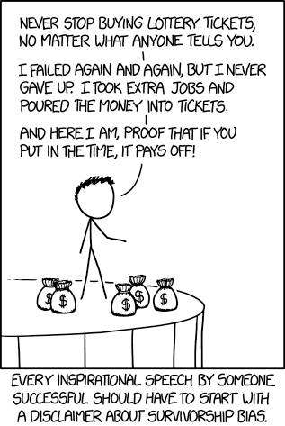
Survivorship Bias
Survivorship Bias: the bias of recognizing those the made it past a selection event or process while ignoring those that didn’t.
XKCD Creative Commons license

Slide 24
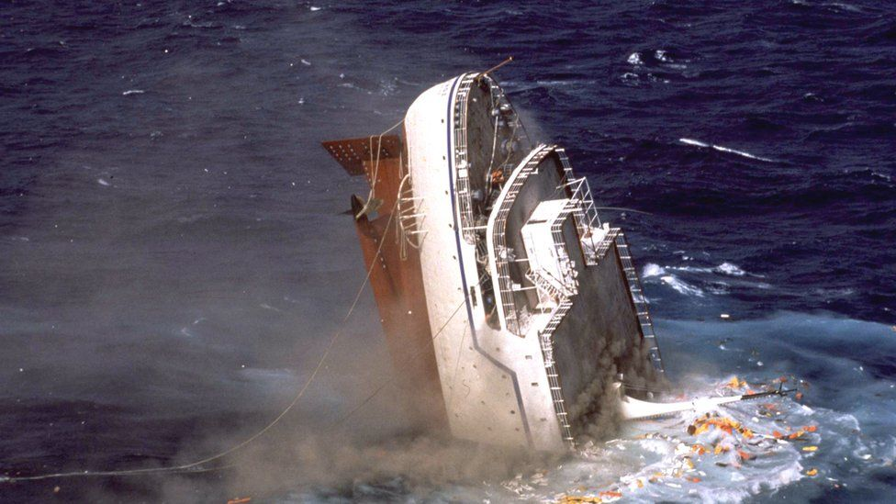
Sunk Cost Error
Sunk Cost Error: the tendency to continue with a project because of the resources already invested, even if the benefits will not recover those costs.

Slide 25
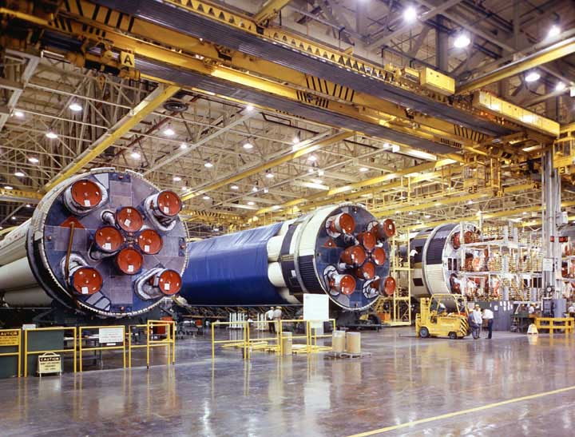
Stay Involved
"The technical people must keep their hands dirty and actively work on in-house projects selected specifically for the purpose of updating their knowledge and increasing their competence."
-Werhner Von Braun

Slide 26
Try New Ideas
Whether original or from another source, give new ideas a trial.
Honestly assess trials. Don’t be afraid to discontinue those that don’t work.
Don’t automatically discount staff ideas. Give them credit when they work.

Slide 27
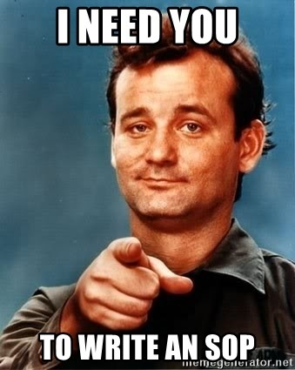
Fresh SOPs
Keep your SOP manuals up to date.
Should be written by someone who does the work
SOPs are a great way to make regulatory compliance automatic

Slide 28
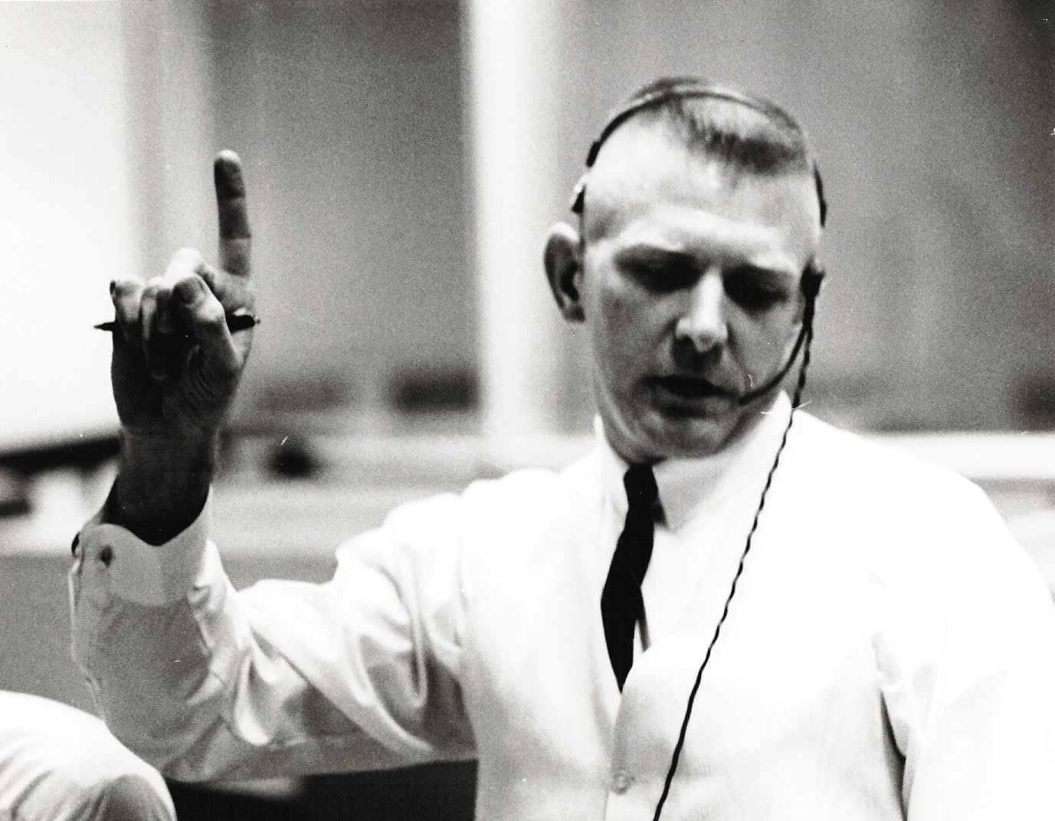
Tough and Competent
From an address Flight Director Gene Kranz said to his team following the death of three astronauts in the Apollo 1 fire.
Tough means we are forever accountable for what we do or what we fail to do.
Competent means we will never take anything for granted.

Slide 29
Questions?
Richard Lobinske rlobinske@gmail.com
850-284-2054

